Slide 1
EnergyPlus Basics

Slide 2
Content
Interface
Algorithm
Building Scheme
Output File

Slide 3
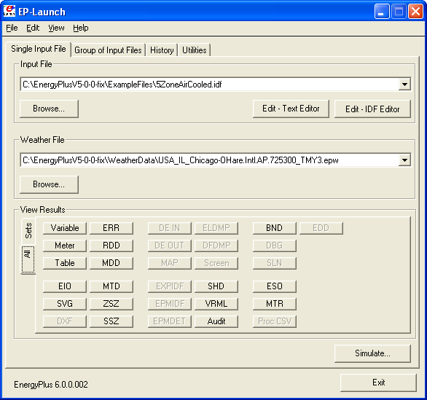
EnergyPlus Interface – EP-Launch
Input file:
Choose input file
Edit input file via:
Test
IDF-Editor
Weather file
Results:
Sheets;
Texts;
HTML;
DXF;

Slide 4
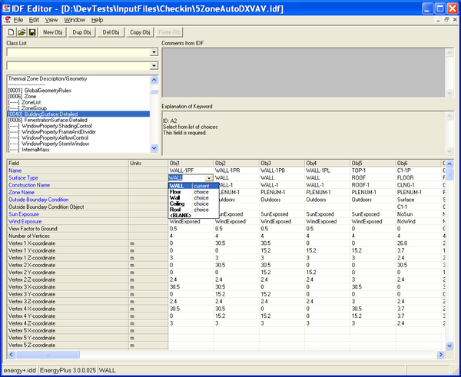
EnergyPlus Interface – IDF-Editor
Edit Menu
Classes
Field Description
Objects

Slide 5
EnergyPlus Interface – Classes
Simulation parameters
Compliance object
Location and climate
Schedules
Surface construction element
Thermal zones and surfaces
Advanced construction, surface, zone concepts
Detailed ground heat transfer
Room air models
Internal gains
Daylighting
Zone airflow
Natural ventilation and duct leakage
Exterior equipment
HVAC templates
HVAC design object
Zone HVAC controls and thermostats
Zone HVAC forced air units
Zone HVAC radiative/convective units
Zone HVAC air loop
Zone HVAC equipment connections
Fans
Coils
Evaporative coolers
Humidifiers and dehumidifiers
Heat recovery
Unitary equipment
Variable refrigerant flow equipment
Controllers
Air distribution
Node-branch management
Pumps
Plant-condenser flow control
Non-zone equipment
Solar collectors
Plant heating and cooling equipment
Condenser equipment and heat exchangers
Water heaters and thermal storage
Plant-condenser loops
Plant-condenser control
Energy management system
External interface
User defined HVAC and plant component models
System availability managers
Setpoint managers
Refrigeration
Demand limiting controls
Electric load center-generator specifications
Water system
Operational faults
General data entry
Hybrid model
Performance curves
Performance tables
Fluid properties
Economics
Parametrics
Output reporting

Slide 6
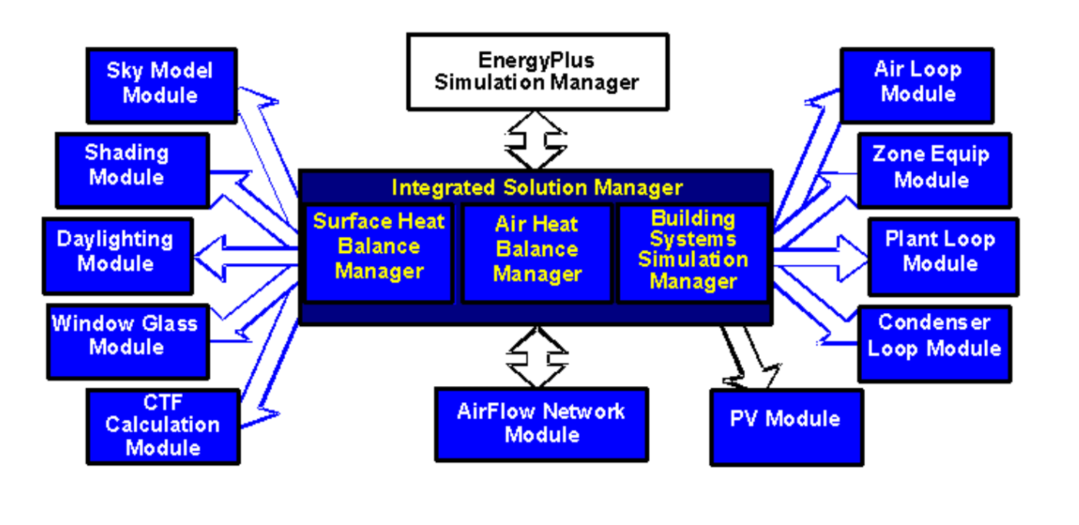
Algorithm – General Model

Slide 7
Algorithm
Engineering Reference: https://energyplus.net/sites/default/files/pdfs_v8.3.0/EngineeringReference.pdf
Integrated solution manager
Surface heat balance manager/processes
Climate, sky and solar/shading calculations
Solar radiation reflected from exterior surfaces
Daylighting and window calculations
Air heat balance manager/processes
Building system simulation system manager/processes
Loop, equipment sizing and other design data
Demand limiting
Alternative modeling processes
Performance curves and lookup tables
Economics calculation
Special modules/reporting
Operational faults
Simulation models – encyclopedia reference

Slide 8
Building Scheme
Simulation control:
Algorithms;
Simulation period;
Timestep
Construction:
Zone;
Building/room geometry;
Wall/roof/floor material;
Location;
HVAC system:
System type;
Scheduling;
Occupancy:
Scheduling;
Weather:
Ground temperature;
Weather file;

Slide 9
Output Files
Tables (HTML form)
Errors
RDD
Spreadsheets
Drawing files:
DXF – drawing of building surfaces
SVG – block diagram of HVAC system components

